Slide 1


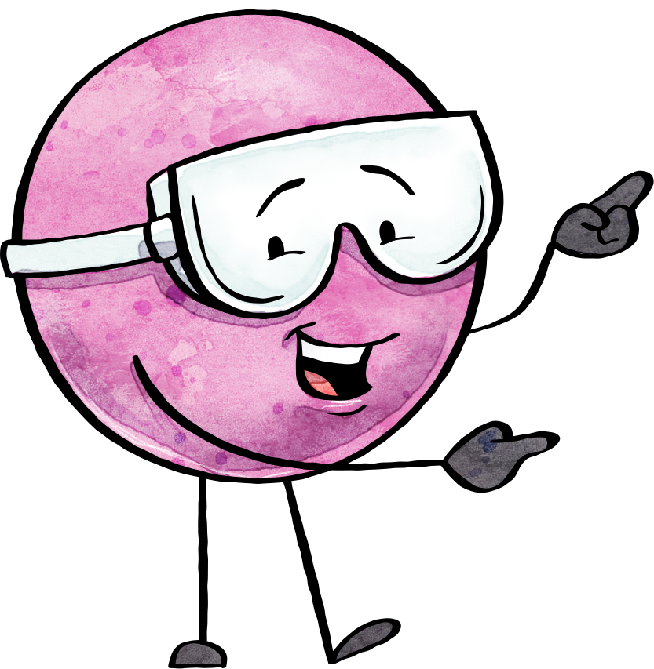

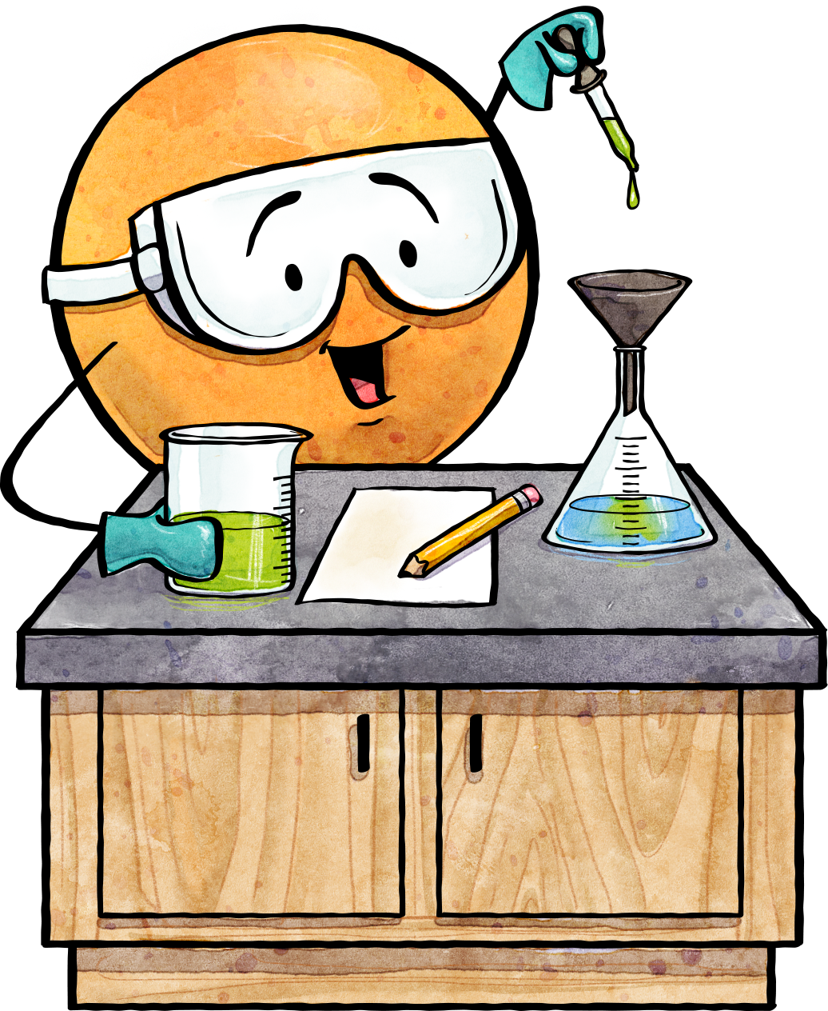
Scientific Method Task Cards
1
Scientific Method
All scientific investigations begin with:
(a) Forming a hypothesis.
(b) Conducting an experiment.
(c) Asking a question or observing a problem.
(d) Forming a conclusion.
Directions: Complete the question or task found on each of the cards. Record your answers on the answer sheet or on your notebook paper as directed by your teacher.
© Amy Brown Science
© Amy Brown Science
2
Scientific Method
3
Scientific Method
The steps of the scientific method are listed below, but they are not in the correct order. What is the correct order of the steps in the scientific method?
(a) Conduct the experiment.
(b) Form a hypothesis.
(c) Form a conclusion.
(d) Report your results.
(e) Make an observation.
(f) Analyze the data.
Often a scientist collects data that is numerical. For example, the scientist might measure the length of growing root tips, or determine the rate of a particular reaction.
What is the name of this type of data?
© Amy Brown Science
© Amy Brown Science

Slide 2
4
Scientific Method
5
Scientific Method
Sometimes a scientist collects data that is descriptive in nature. For example, “When X and Y are mixed together, they turn a blue color.”
What name is given to the type of
data that is descriptive rather than numerical?
The data collected during an experiment are of little use unless they are organized.
In what ways might data be
logically organized?
© Amy Brown Science
© Amy Brown Science
6
Scientific Method
7
Scientific Method
Forming a hypothesis is an important step in the scientific method.
What is the purpose of the hypothesis in an experiment?
A student is conducting an experiment to test how temperature might affect the action of a particular enzyme.
How might a hypothesis for this experiment be stated?
© Amy Brown Science
© Amy Brown Science

Slide 3
8
Scientific Method
9
Scientific Method
True or False?
Although a hypothesis may be supported by evidence, it can never be proven true beyond all doubt since new data might indicate that the hypothesis does not hold true in all instances.
How is it determined if a hypothesis is correct or incorrect?
© Amy Brown Science
© Amy Brown Science
10
Scientific Method
11
Scientific Method
Define the term “controlled experiment.”
Every experiment should consist of two groups.
Name these two groups.
© Amy Brown Science
© Amy Brown Science

Slide 4
12
Scientific Method
13
Scientific Method
In an experiment, what is the purpose of the experimental group?
In an experiment, what is the purpose of the control group?
© Amy Brown Science
© Amy Brown Science
14
Scientific Method
15
Scientific Method
Which one of the following steps would occur last?
(a) Analyze the data from the experiment.
(b) Organize the data into charts, tables, and graphs.
(c) Publish the results.
(d) Form a conclusion based on the data.
(e) Repeat the experiment to determine
if the data from the first experiment
is reliable.
There are two variables in every experiment. Name the two variables.
© Amy Brown Science
© Amy Brown Science

Slide 5
16
Scientific Method
17
Scientific Method
Give an example of an experiment that uses quantitative data.
Give an example of an experiment that uses qualitative data.
© Amy Brown Science
© Amy Brown Science
18
Scientific Method
19
Scientific Method
The variable that is deliberately changed in an experiment is called the:
(a) Dependent variable
(b) Controlled variable
(c) Hypothetical variable
(d) Independent variable
The variable that is the result of the independent variable is called the:
(a) Dependent variable
(b) Controlled variable
(c) Hypothetical variable
(d) Unidentifiable variable
© Amy Brown Science
© Amy Brown Science

Slide 6
20
Scientific Method
21
Scientific Method
Catalase is an enzyme that speeds up the breakdown of hydrogen peroxide in cells. During this reaction oxygen is given off. A scientist designs an experiment to determine how much oxygen is given off when varying concentrations of catalase are used.
(a) What is the independent variable?
(b) What is the dependent variable?
A student wanted to know which type of sugar would yield the greatest amount of energy for the cell when metabolized during cellular respiration by the mitochondria. The student mixed yeasts in three different sugar solutions: maltose, glucose, and sucrose. The three sets of yeasts were monitored to determine which sugar type yielded the most energy.
Write a hypothesis for this experiment.
© Amy Brown Science
© Amy Brown Science
22
Scientific Method
23
Scientific Method
A student wanted to know which type of sugar would yield the greatest amount of energy for the cell when metabolized during cellular respiration by the mitochondria. The student mixed yeasts in three different sugar solutions: maltose, glucose, and sucrose. The three sets of yeasts were monitored to determine which sugar type yielded the most energy.
What is the purpose of the yeasts?
A student wanted to know which type of sugar would yield the greatest amount of energy for the cell when metabolized during cellular respiration by the mitochondria. The student mixed yeasts in three different sugar solutions: maltose, glucose, and sucrose. The three sets of yeasts were monitored to determine which sugar type yielded the most energy.
Describe a possible control group for this experiment.
© Amy Brown Science
© Amy Brown Science

Slide 7
24
Scientific Method
25
Scientific Method
A student wanted to know which type of sugar would yield the greatest amount of energy for the cell when metabolized during cellular respiration by the mitochondria. The student mixed yeasts in three different sugar solutions: maltose, glucose, and sucrose. The three sets of yeasts were monitored to determine which sugar type yielded the most energy.
What is the independent variable in this experiment?
A student wanted to know which type of sugar would yield the greatest amount of energy for the cell when metabolized during cellular respiration by the mitochondria. The student mixed yeasts in three different sugar solutions: maltose, glucose, and sucrose. The three sets of yeasts were monitored to determine which sugar type yielded the most energy.
What is the dependent variable in this experiment?
© Amy Brown Science
© Amy Brown Science
26
Scientific Method
27
Scientific Method
A properly designed experiment changes only one variable at a time. A student wanted to know which type of sugar would yield the greatest amount of energy for the cell when metabolized during cellular respiration by mitochondria. The student mixed yeasts in three different sugar solutions: maltose, glucose, and sucrose. The three sets of yeasts were monitored to determine which sugar
type yielded the most energy.
List three factors that the student must
keep constant during the experiment.
A student wants to test the effect of different amounts of caffeine on the heart rate of Daphnia, a small crustacean. Describe the experimental groups in this experiment.
© Amy Brown Science
© Amy Brown Science

Slide 8
28
Scientific Method
29
Scientific Method
A student wants to test the effect of different amounts of caffeine on the heart rate of Daphnia, a small crustacean. Describe the control group in this experiment.
A student wants to test the effect of different amounts of caffeine on the heart rate of Daphnia, a small crustacean. What is the independent variable?
© Amy Brown Science
© Amy Brown Science
30
Scientific Method
31
Scientific Method
A student wants to test the effect of different amounts of caffeine on the heart rate of Daphnia, a small crustacean. What is the dependent variable?
Consider an experiment designed to determine glucose production during photosynthesis when leaves are exposed to different wavelengths of light.
(a) What is the independent variable?
(b) What is the dependent variable?
© Amy Brown Science
© Amy Brown Science

Slide 9
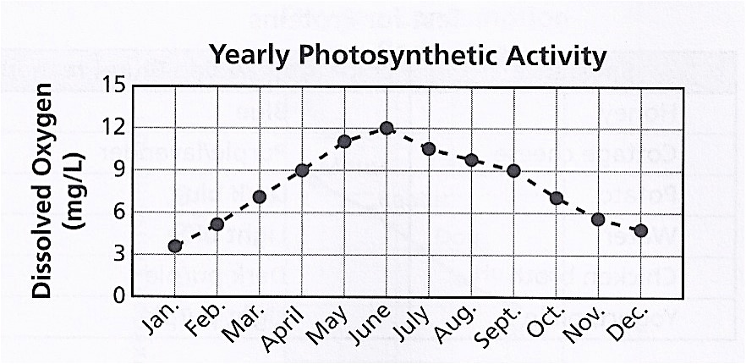
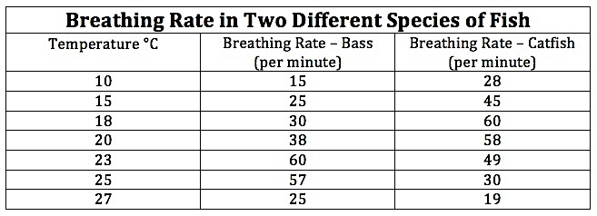
32
Scientific Method
33
Scientific Method
Why is it necessary that only one variable be changed in an experiment, and that all other variables remain constant?
Why must an experiment be repeated many times?
© Amy Brown Science
© Amy Brown Science
34
Scientific Method
35
Scientific Method
Examine the data shown in the graph below.
Study the information in the table.
What conclusion can be reached by the data shown on the graph?
(a) What is the independent variable?
(b) What is the dependent variable?
© Amy Brown Science
© Amy Brown Science

Slide 10
36
Scientific Method
37
Scientific Method
Study the information in the table.
What conclusion can be reached
from this data?
Study the information in the table.
(a) At what temperature will the breathing rate of the bass be the highest?
(b) At 20 ˚C, how does the breathing rate of the bass compare to the breathing rate of the catfish?
© Amy Brown Science
© Amy Brown Science
38
Scientific Method
39
Scientific Method
An experiment is carried out to determine if the boiling point of distilled water is affected by the addition of different types of solutes.
Describe a control group for this experiment.
A scientist is designing an experiment to see how temperature changes affect the volumes of three different gases.
Write a hypothesis for this experiment.
© Amy Brown Science
© Amy Brown Science

Slide 11
40
Scientific Method
41
Scientific Method
A scientist is designing an experiment to see how temperature changes affect the volumes of three different gases.
What is the independent variable?
A scientist is designing an experiment to see how temperature changes affect the volumes of three different gases.
What is the dependent variable?
© Amy Brown Science
© Amy Brown Science
42
Scientific Method
43
Scientific Method
Study the temperature/volume graph.
At what temperature does Gas A have a volume of 50L?
Study the temperature/volume graph.
At 50 °C, what is the volume of Gas B?
© Amy Brown Science
© Amy Brown Science

Slide 12
44
Scientific Method
45
Scientific Method
Study the temperature/volume graph.
Predict the volume of Gas C if the temperature is lowered to –200 °C.
Study the temperature/volume graph.
At what temperature will Gas B have a volume of 53 L?
© Amy Brown Science
© Amy Brown Science
Scientific Method
Scientific Method
© Amy Brown Science
© Amy Brown Science

Slide 13
Scientific Method
Scientific Method
© Amy Brown Science
© Amy Brown Science
Scientific Method
Scientific Method
© Amy Brown Science
© Amy Brown Science

Slide 14



Created by Amy Brown
Copyright © Amy Brown Science
All rights reserved by author.
This document is for your classroom use only.
This document may not be electronically distributed or posted to a web site.
Clipart Credit:

